Slide 1
Associated Schools project network-Austria
24 March 2014
Friederike Koppensteiner
Austrian Commission for UNESCO

Slide 2
Unesco constitution 1945
UNESCO – one of 16 Specialized Agencies of the United Nations
Education – Science – Culture
“Since wars begin in the minds of men, it is in the minds of men that the defences of peace must be constructed".
(Preamble of the UNESCO-Constitution)

Slide 3
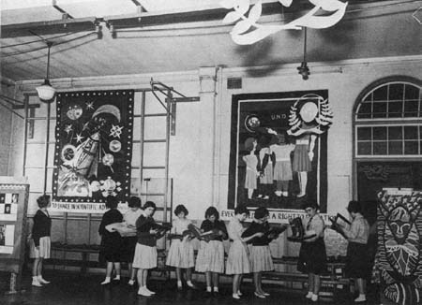
1952 UNESCO General Assembly
Education with regards to:
goals of the United Nations
principles of the Universal Declaration of Human Rights

Slide 4
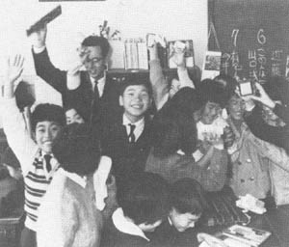
Foundation in 1953
33 schools in 15 Member States
Belgium
Germany
Costa Rica
Ecuador
France
Japan
Yugoslavia
Norway
Pakistan
Netherlands
Philippines
Sweden
Switzerland
Uruaguay
United Kingdom of Great Britain

Slide 5
Goals of associated schools
Education for all
Educational Topics:
Women Rights
Studying of other cultures
Human Rights and the system of the United Nations

Slide 6
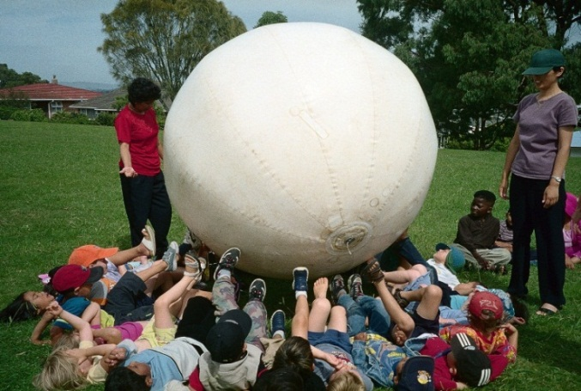
Four Focal Points
Global Learning, „Global Citizenship“
Education for Sustainable Development, Climate Change, Environmental Education
Peace and Human Rights
Cultural Heritage and
Intercultural Dialogue

Slide 7
UNESCO Schools worldwide
The international Network:
More than 9600 Schools in 180 Countries

Slide 8
Unesco – schools in austria
1957: GWIKU Wien XVIII Haizingergasse first Austria school in the ASPnet
2014: 82 Associated Schools in Austria
Distribution of UNESCO Associated Schools in Austria

Slide 9
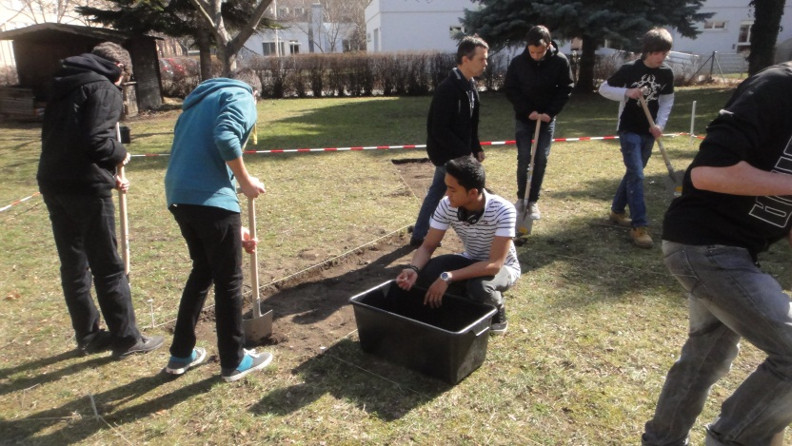
Unesco – school „F26“
Education for Sustainable Development: „Schoolgarden reloaded“
World Heritage: Exhibitions „Myanmar“
International School Partnerships
Peace Education: „Peer Mediation“

Slide 10
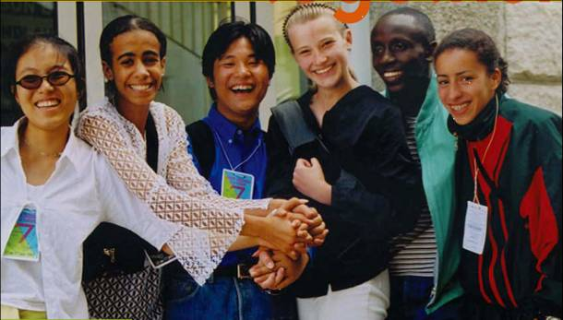
Four Pillars of UNESCO-Schools
Learning to know
Learning to do
Learning to be
Learning to live together

Slide 11
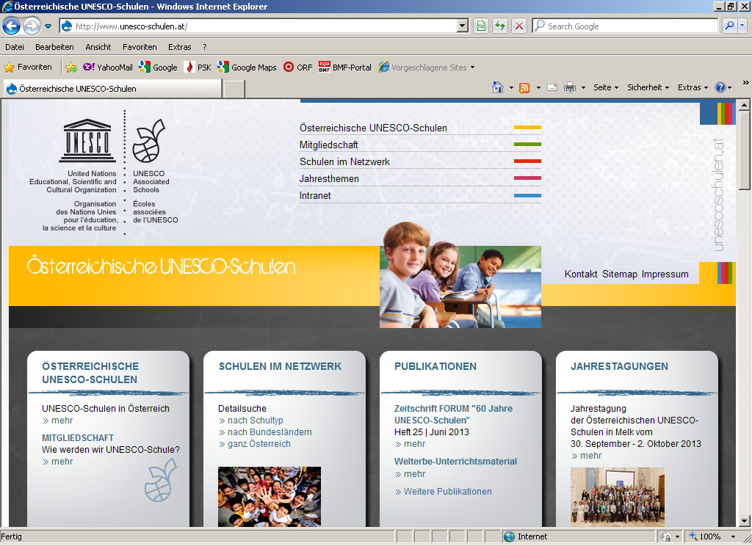
Thank you for your attention!
Contact
Friederike Koppensteiner
Austrian ASPnet Coordintor
Austrian Commission for UNESCO
Universitätsstraße 5/12, A-1010 Vienna
Tel: (+43 1) 526 13 01–17
Fax: (+43 1) 526 13 01–20
koppensteiner@unesco.at
www.unesco-schulen.at

